Slide 1


Labs of Physics for Engineers
Simple Harmonic Motion
Physics Experiment Teaching Center

Slide 2
Aim
1. To measure the spring constant of a spiral spring.
2. To measure the period of oscillation of spring and mass system and compare it to the theoretical value.

Slide 3
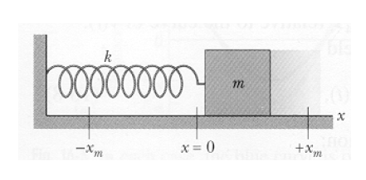
Theory
In the absence of friction, a mass ‘m’ resting on a horizontal plane and attached to a spiral spring will, if disturbed from its equilibrium position, oscillate with a period ‘T’ given by:

Slide 4
Theory
Hooke’s Law states that the force exerted by the spring is proportional to the distance from the equilibrium position (x₀) and is directed towards that position:
Thus the spring constant can be determined by applying varying forces to stretch the spring different distances. A plot of force versus distance will result in a straight-line graph of slope ‘k’.

Slide 5
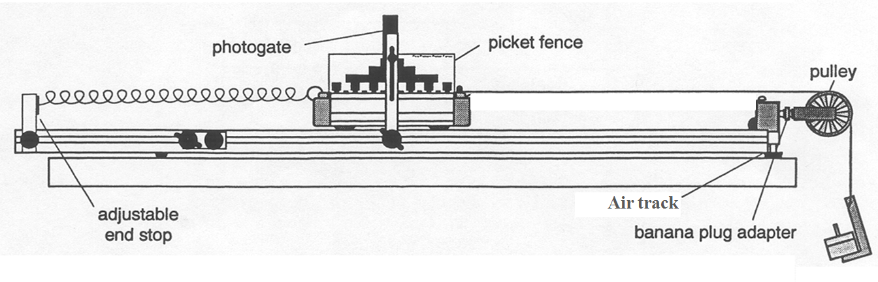
Apparatus

Slide 6
Procedure
PART 1 – Working out the spring constant.
1. Weigh the cart and picket fence and record this value in your report. The air track has been setting level. Set up the air track and cart as shown below. Attach a string to the end of the cart and hang a mass hanger over the pulley.

Slide 7
PART 1 – Working out the spring constant
2. Record the equilibrium position of the cart relative to the adjustable end stop. Add 12.6 g progressively after each result, recording the cart's position in each case. The displacement recorded is the distance from equilibrium.
Mass on the Mass Hanger (×10⁻³kg) | Force on the Springs F (×10⁻³N) | Position Relative to End Stop (cm) | Displacement x (cm)

Slide 8
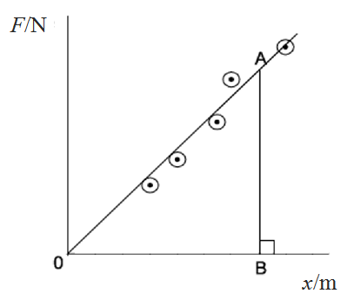
PART 1 – Working out the spring constant
3. Plot a graph of Force versus Displacement and calculate the slope of the best-fit straight line. This slope is the effective spring constant ‘k’ (N/m).

Slide 9
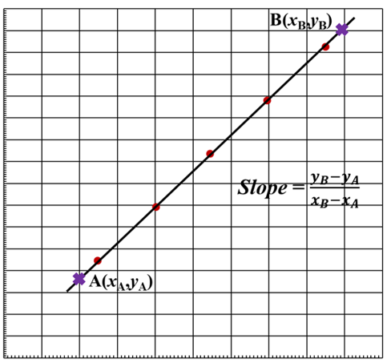
Graph

Slide 10
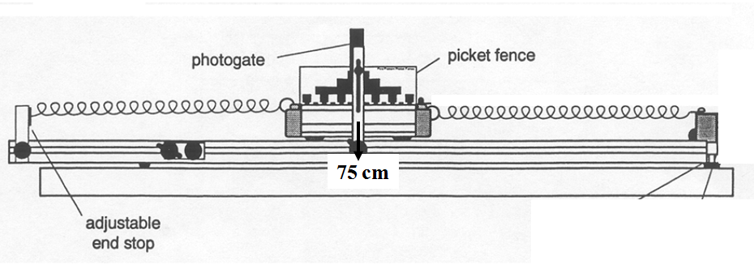
PART 2 – Measuring the experimental period
1. Set up the air track and cart as shown below. Position the photo-gate so that the 30.0 mm flag on cart will block the beam. Adjust the position of the photo-gate so that this flag is centred on the beam.

Slide 11
one period of oscillation of spring
photo-gate
photo-gate
photo-gate
photo-gate
photo-gate
flag
flag
flag
flag
flag
Direction
Direction
Direction
Direction
Direction
Begin
Stop

Slide 12
PART 2 – Measuring the experimental period
2. Turn on the Smart Timer and pull the cart back a good distance and then release it. Once the cart has oscillated a few times the period will appear on the screen of the Smart Timer. Record this figure in your report.
3. Add the 25.2 g mass bar to the cart and repeat the measurement of the mean period.
4. Calculate the percentage difference between the theoretical and experimental values of the period.

Slide 13
PART 2 – Measuring the experimental period
Experimental period T (ms) | Cart Alone | Cart with Mass
1
2
3
4
5
Average Time (ms)

Slide 14
Sample Conclusions
A horizontal air track apparatus was used to measure the acceleration of a mass of 450 grams in response to an applied force. The applied force was due to gravity acting on part of the 450 grams. We have found that the acceleration of the mass is indeed proportional to the applied force and that the slope of a graph of force versus acceleration gave a straight line with slope 0.440 kg. This is close to the expected value of 450 grams, and in reasonable agreement with Newton’s Second Law.

Slide 15
Conclusions
Write a succinct summary of what you have done. State the goal and method of the experiment. State your main results, i.e., is the period of the oscillation correctly given by , within the experimental uncertainties?

